Slide 1
Real-time Stabilization and 3D Reconstruction of Hand Gestures and Finger Movement Traces Using LED-Equipped Gloves
Team 5 - 10/08/2024

Slide 2
Introduction
Project Goal:
Develop a mobile app that captures and processes real-time hand gestures using LED-equipped gloves and a rolling shutter camera, with a focus on key use cases across various platforms.
Key Features:
Real-time gesture tracking and 3D movement reconstruction.
Advanced image processing for gesture refinement.
Machine learning integration for accurate recognition.
Privacy protection through filtering irrelevant data.
Project/Application Actors:
User - The end-user who interacts with the application.

Slide 3
Use Cases
Mobile Application
VR/AR
Image Processing
Machine Learning
3D Visualization

Slide 4
1.Mobile Application (Use Case Summary)
The mobile application we are developing will allow the user to start and stop finger tracking. Additionally, users will be able to set up both the camera and LED gloves. However, there may be exceptions that cause errors during each function. When interacting with the gloves and camera, the user might encounter errors triggered by one of these exceptions. Since the processing of LED glove and camera actions occurs on the server side, users may also face server-related exceptions. The setup processes for the camera and LED gloves may result in specific device-related errors.

Slide 5
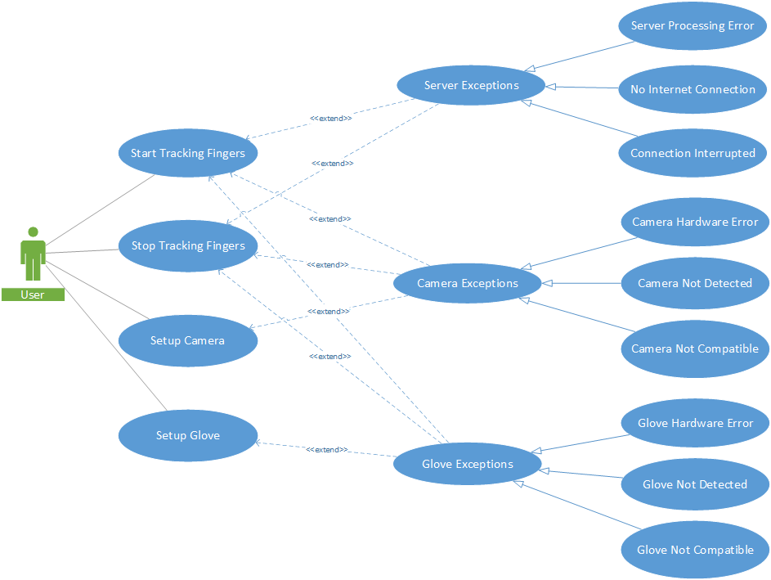
1.Mobile Application (Use Case Diagram)

Slide 6
2.VR/AR (Use Case Summary)
When the project is implemented on the AR/VR platform, users will be able to interact with virtual buttons, icons, and objects generated by the software. The system will also track the user's finger and hand movements, along with monitoring tremors in the hands and fingers by collecting real-time hardware and calibration data. Users will have the ability to optimize both the camera and LED gloves for seamless integration with the AR/VR interface. However, potential backend exceptions may arise, triggered either by hardware malfunctions or server issues. These hardware and server exceptions are consistent with those encountered in the mobile use case.

Slide 7
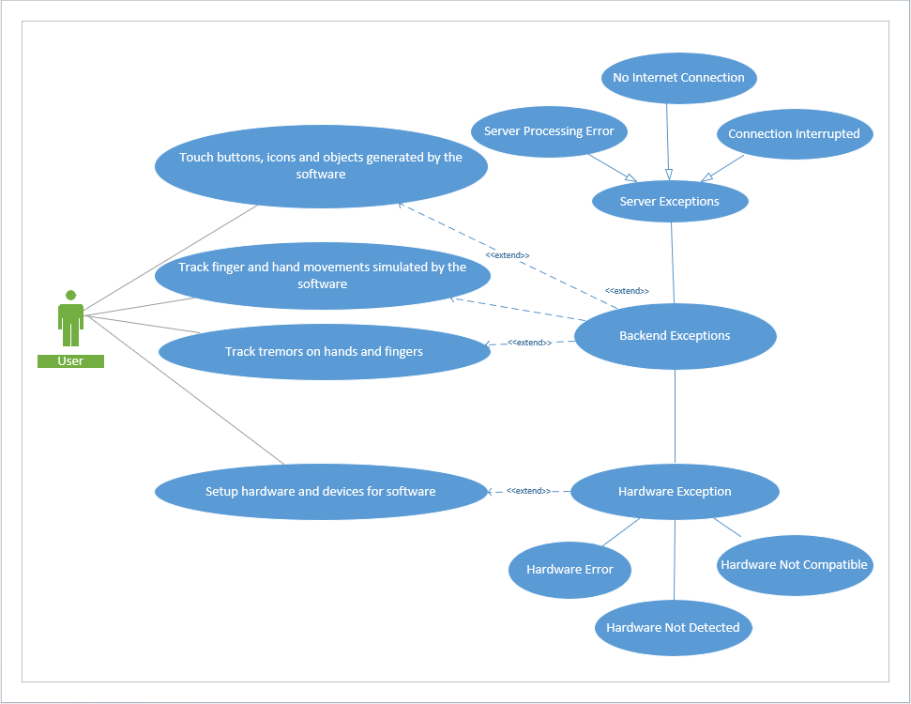
2.AR/VR (Use Case Diagram)

Slide 8
3.Image Processing (Use Case Summary)
This use case describes the Image Processing Module's role in real-time gesture tracking, allowing users to start and stop tracking hand movements via a simple interface. Upon clicking "Record Gestures," the camera captures frames using the Camera2 API. These frames undergo pre-processing, including sharpening, denoising, edge detection, and thresholding to improve image quality. Key features such as 2D coordinates, depth, and timestamps are extracted using OpenCV, compiling the data into a 4D structure (X, Y, Z, T) representing the LED’s path in 3D space. Kalman Filters and spline interpolation smooth the gesture path for accuracy. The final data, output as a 4D NumPy array, is ready for further analysis by the Machine Learning Module. The system handles exceptions like camera malfunctions and processing errors, ensuring reliable gesture recognition and smooth user interaction.

Slide 9
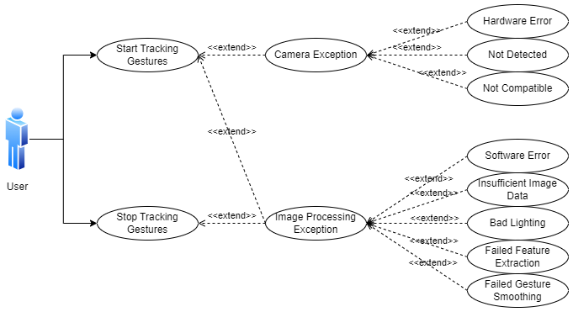
3.Image Processing (Use Case Diagram)

Slide 10
4.Machine Learning (Use Case Summary)
This use case outlines the process of applying a machine learning module for adaptive Human-Computer Interaction (HCI) by smoothing gesture trajectories in real-time. The system starts by applying a Kalman filter to reduce noise in the raw gesture data, ensuring smoother and more accurate motion tracking. If the noise level exceeds a certain threshold, a GRU-based RNN model is activated as a secondary layer to further refine the gesture data. The module is optimized for mobile use, ensuring that gesture smoothing is both efficient and responsive. Once processed, the final smoothed trajectory is rendered on the mobile device for user interaction, providing real-time feedback and ensuring accurate recognition even in noisy or shaky environments.

Slide 11
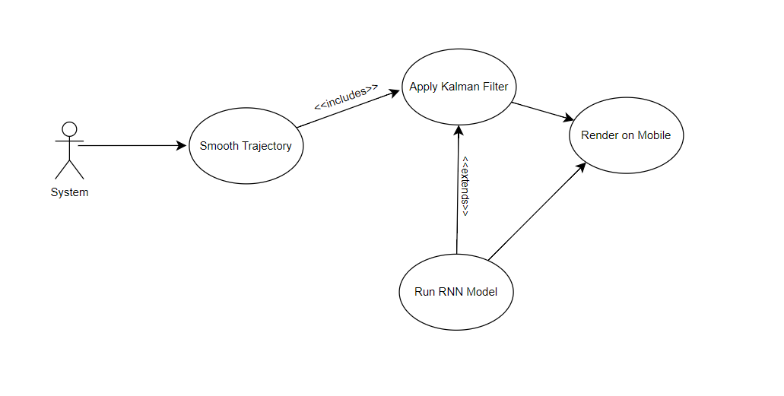
4.Machine Learning (Use Case Diagram)

Slide 12
5.3D Modeling (Use Case Summary)
This use case outlines the process of using OpenGL for real-time hand gesture recognition and visualization within an interactive system.The user performs gestures that are captured and processed by the mobile application, which reconstructs hand pose data from a low-cost capture system (RoFin’s HPR model). Using OpenGL, the system visualizes these gestures, providing immediate feedback to the user. This is then translated into commands that can be executed on target systems, such as video games or smart home devices, helping the user to control these systems by using natural hand movements.

Slide 13
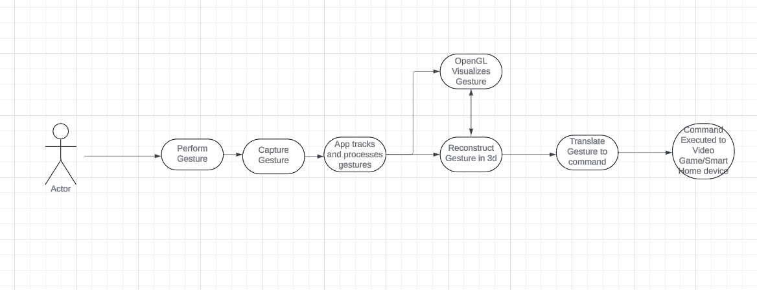
5.3D Modeling - Hand Pose Commands for Video Games/Smart Homes (Use Case Diagram)

Slide 14
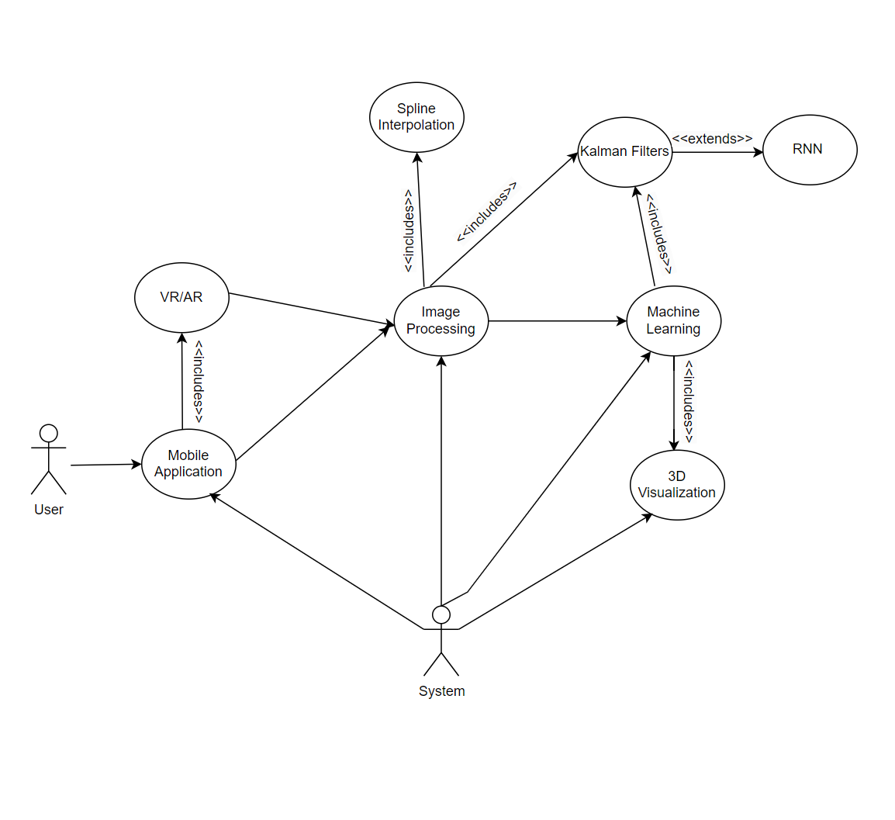
Joint Use Case Diagram

